Slide 1
Cardiac Simulator
Code Breakers
Venkata Sravya Kancharla
Dinesh Vadicherla
Chandrashekar Vasamsetti
Cher-Xa Thao

Slide 2
Overview
Introduction
Existing System
Proposed System
User Interface
Opcodes
Implementation
Challenges
Lessons Learnt
Future Enhancements
Conclusion

Slide 3
Introduction
Practical aid to understanding computer and computer programming
Tool for teaching how computer works
Developed by David Hagelbarger at Bell Laboratories
Serves as a teaching guide

Slide 4
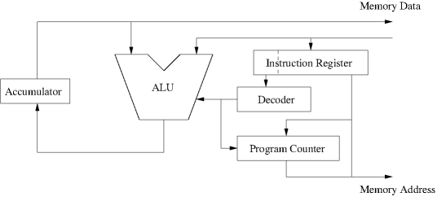
Cardiac CPU Architecture

Slide 5
Proposed System
Two modes
Manual mode
User executes instruction on his own
Autorun mode
Set of instructions executed one by one with each step function

Slide 6
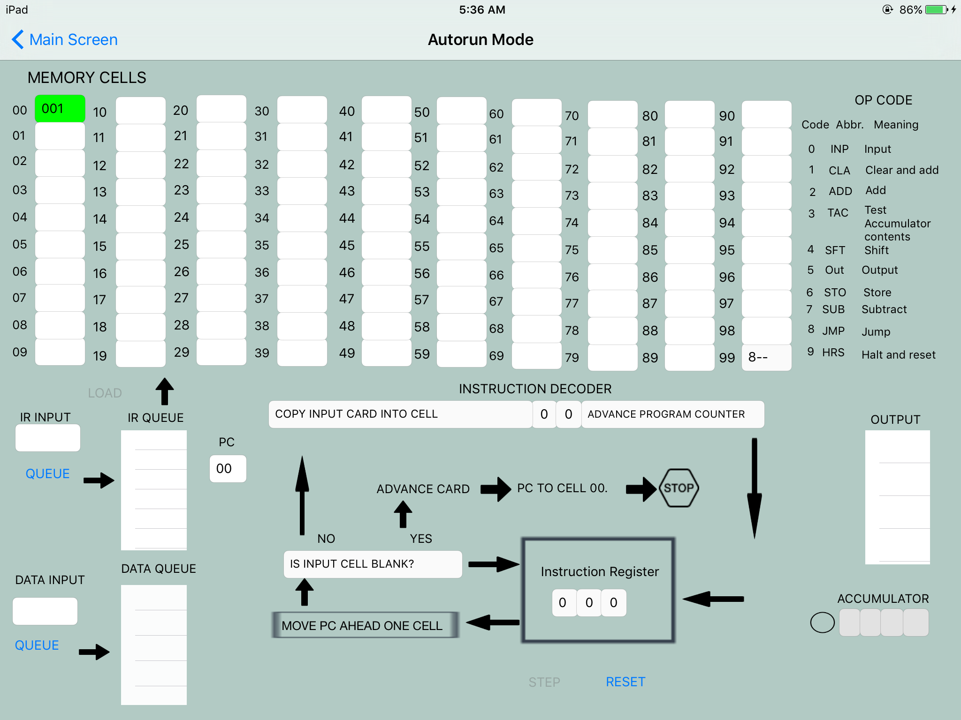
User Interface

Slide 7
Op Codes
0 - Read input card into cell
1 - Clear accumulator and add the contents
2 - Add the cell contents to accumulator
3 - Accumulator test
4 - Shift
5 – Print contents of cell on output card
6 – Store contents of accumulator in cell
7 - Subtract
8 - Jump
9 - Halt and reset

Slide 8
Functionalities
Addition
Subtraction
Unconditional Jump
Conditional Jump
Multiplication
Shifting

Slide 9
Challenges Faced
Concepts
User Interface
Multiplication program
UIScrollView
Implementing Jump functionality

Slide 10
Lessons Learnt
Working behavior of a programming language
Execution of instructions
Programming techniques including loops and multiplication
Learned implementing scroll view

Slide 11
Future Enhancements
Providing a guide for user
Bootstrapping and loading programs
Subroutines
Developing programs
Assemblers and compilers

Slide 12
Conclusion
Mainly useful for students
Execution of different set of programs
Teaching guide

